Slide 1
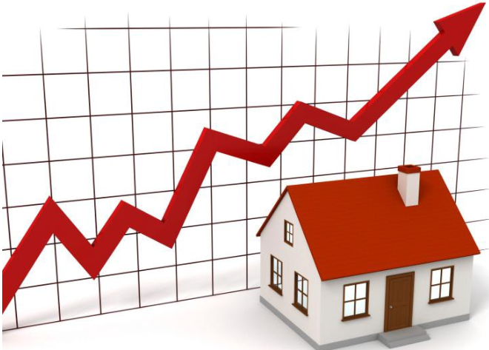

HOUSING: PRICE PREDICTION
SUBMITTED BY: DILIP KUMAR

Slide 2
CONTENTS
Introduction
Overview
Let’s start the Data-Analysis.
Exploratory Data Analysis
Data Pre-Processing
Observations
Conclusion

Slide 3
Introduction
You are required to model the price of houses with the available independent variables. This model will then be used by the management to understand how exactly the prices vary with the variables. They can accordingly manipulate the strategy of the firm and concentrate on areas that will yield high returns. Further, the model will be a good way for the management to understand the pricing dynamics of a new market.
Housing prices are an important reflection of the economy, and housing price ranges are of great interest for both buyers and sellers. In this project, house prices will be predicted given explanatory variables that cover many aspects of residential houses. The goal of this project is to create a regression model that are able to accurately estimate the price of the house given the features.
Let’s start the Data-Analysis.

Slide 4
Overview
In this paper, several tests have been performed using linear regression and particle swarm optimization methods to perform house price prediction. Based on the NJOP data of 9 houses, the system is modeling house price predictions into 7 models each of them represents one area. The area modeling includes Kelurahan Karang Besuki, Tunggulwulung, Lowokwaru, Puncak Trikora, Sumbersari, Dinoyo, Manggar. Based on the result from particle test, iteration test and inertia weight test can be concluded that M-1 represents Karang Besuki area get the best parameter for optimal prediction. Those best values of parameters obtained are 1800 particles, 700 iterations and of inertia weight 0.4 and 0.8 can get minimum prediction error RMSE as IDR 14.186. For the other model, the error prediction values are still large. Using different methods that match the time-series data will be used in the future research to obtain smaller error prediction values and using more data to get the better result.
Let’s start the Data-Analysis.

Slide 5
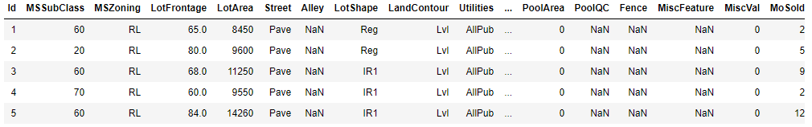
Dataset overview
• Number of data points in train data:1460.
• Number of features in train data: 81.
• Number of data points in test data: 1459.
• Number of features in test data: 80
• Data contains numerical as well as categorical variable.
• With 79 explanatory variables describing (almost) every aspect of residential homes in Ames, Iowa, this competition challenges you to predict the final price of each home
Let’s start the Data-Analysis.

Slide 6
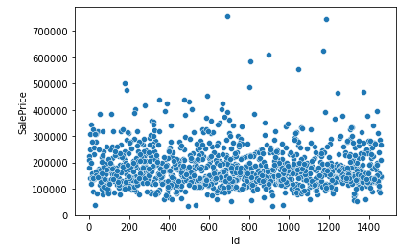
The response variable – Saleprice
Let’s start the Data-Analysis.

Slide 7
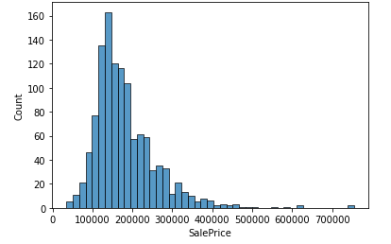
Distribution of sale prices
Let’s start the Data-Analysis.

Slide 8
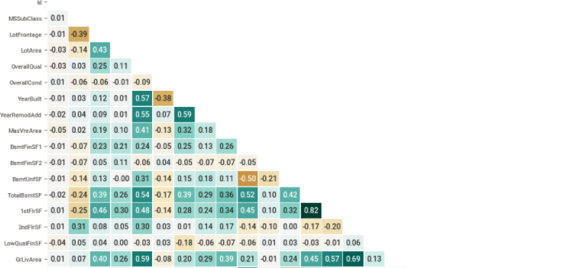
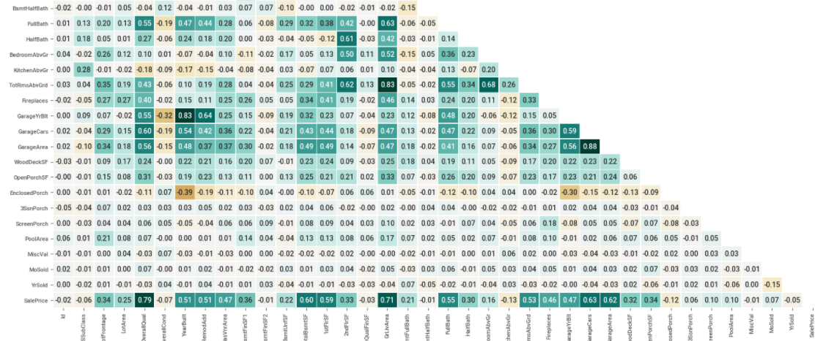
Correlations
Let’s start the Data-Analysis.

Slide 9
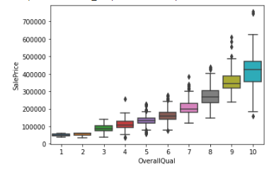
Relationship between Quality and Sale Price
Let’s start the Data-Analysis.

Slide 10
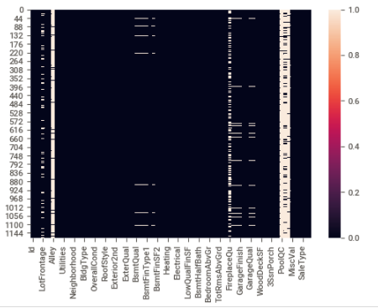
Missing Values
Let’s start the Data-Analysis.

Slide 11
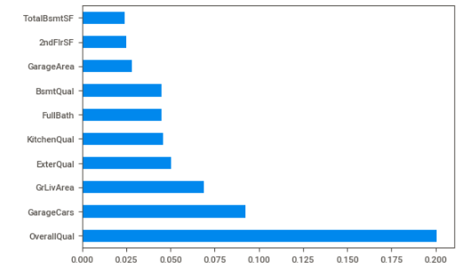
Top Ten Feature
Let’s start the Data-Analysis.

Slide 12
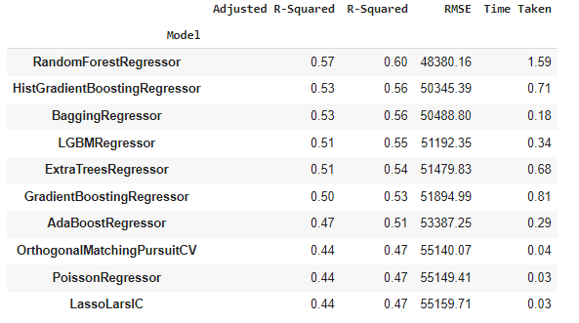
Lazy Test of Model selection
Let’s start the Data-Analysis.

Slide 13
Observations :
1. In this study, our models are trained with 18-year of housing property data utilising stochastic gradient descent (SGD) based support vector regression (SVM), random forest (RF) and gradient boosting machine (GBM). We have demonstrated that advanced machine learning algorithms can achieve very accurate prediction of property prices, as evaluated by the performance metrics.
First, our study has shown that advanced machine learning algorithms like SVM, RF and GBM, are promising tools for property researchers to use in housing price predictions. However, we must be cautious that these machine learning tools also have their own limitations. There are often many potential features for researchers to choose and include in the models so that a very careful feature selection is essential.
Second, many conventional estimation methods produce reasonably good estimates of the coefficients that unveil the relationship between output variable and predictor variables Based on these estimates, investigators can interpret the results and make policy recommendations.
Third, the computation of machine learning algorithms often takes much longer time than conventional methods such as hedonic pricing model. The choice of algorithm depends on consideration of a number of factors such as the size of the data set, computing power of the equipment, and the availability of waiting time for the results.
Enter title here
Click here to add content of the text，and brifly explain your point of view
Enter title here
Click here to add content of the text，and briefly explain your point of view

Slide 14
Conclusion
To conclude, the application of machine learning in property research is still at an early stage. We hope this study has moved a small step ahead in providing some methodological and empirical contributions to property appraisal, and presenting an alternative approach to the valuation of housing prices. Future direction of research may consider incorporating additional property transaction data from a larger geographical location with more features, or analysing other property types beyond housing development.For the other model, the error prediction values are still large. Using different methods that match the time-series data will be used in the future research to obtain smaller error prediction values and using more data to get the better result..
Let’s start the Data-Analysis.

Slide 15
THANK YOU
SUBMITTED BY: DILIP KUMAR

